Slide 1
The aptly named Movie App
Hirviniemi Elias, Hirvonen Mikko, Jartti Jaakko, Putaansuu Valtteri

Slide 2
Who did what?
And for how long?

Slide 3
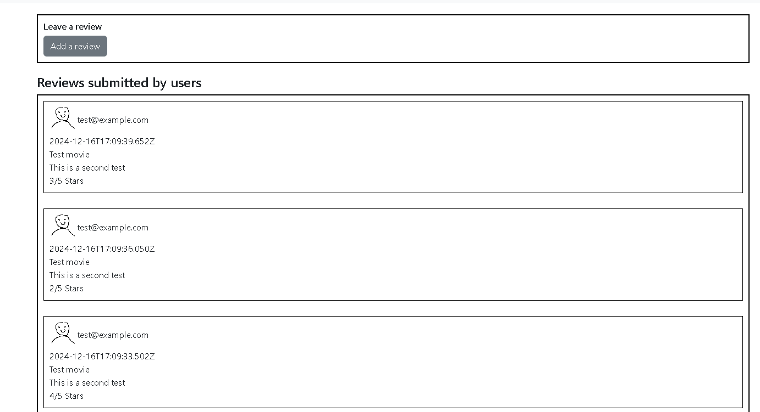
Jaakko Jartti / Reviews page etc.
Worked on:
Reviews, both frontend & backend
The universal header
Authentication & authorization
API tests
Misc. Bug fixes
Total hours: 43

Slide 4
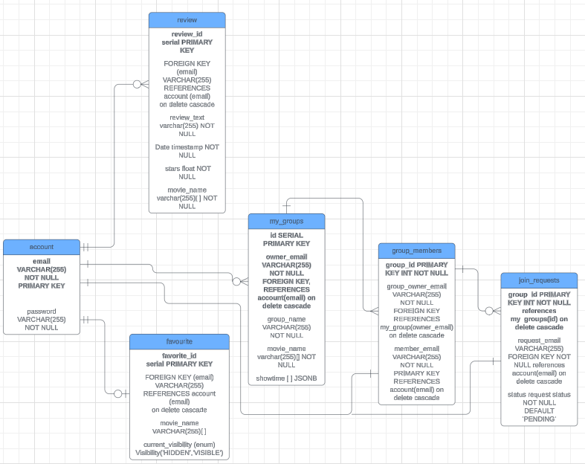
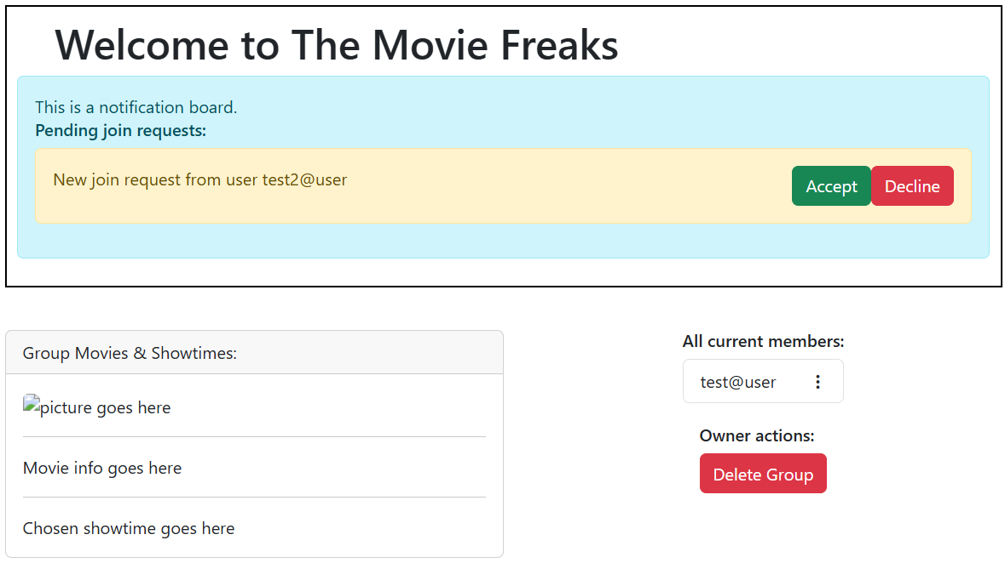
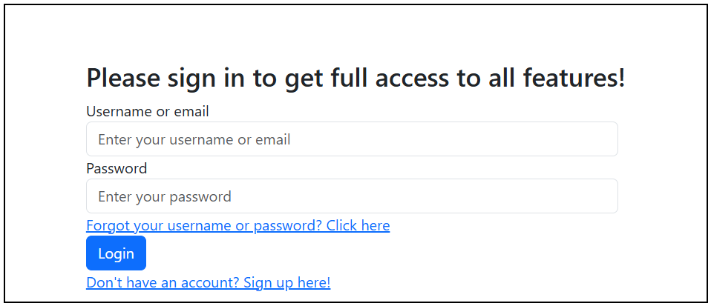
Elias Hirviniemi
Worked on:
Initial planning
Database
UI
Groups (frontend & backend)
account / profile
Total hours: approximately 100h

Slide 5
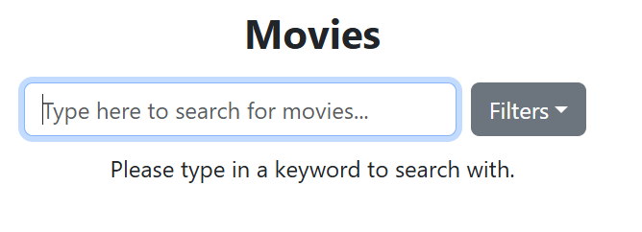
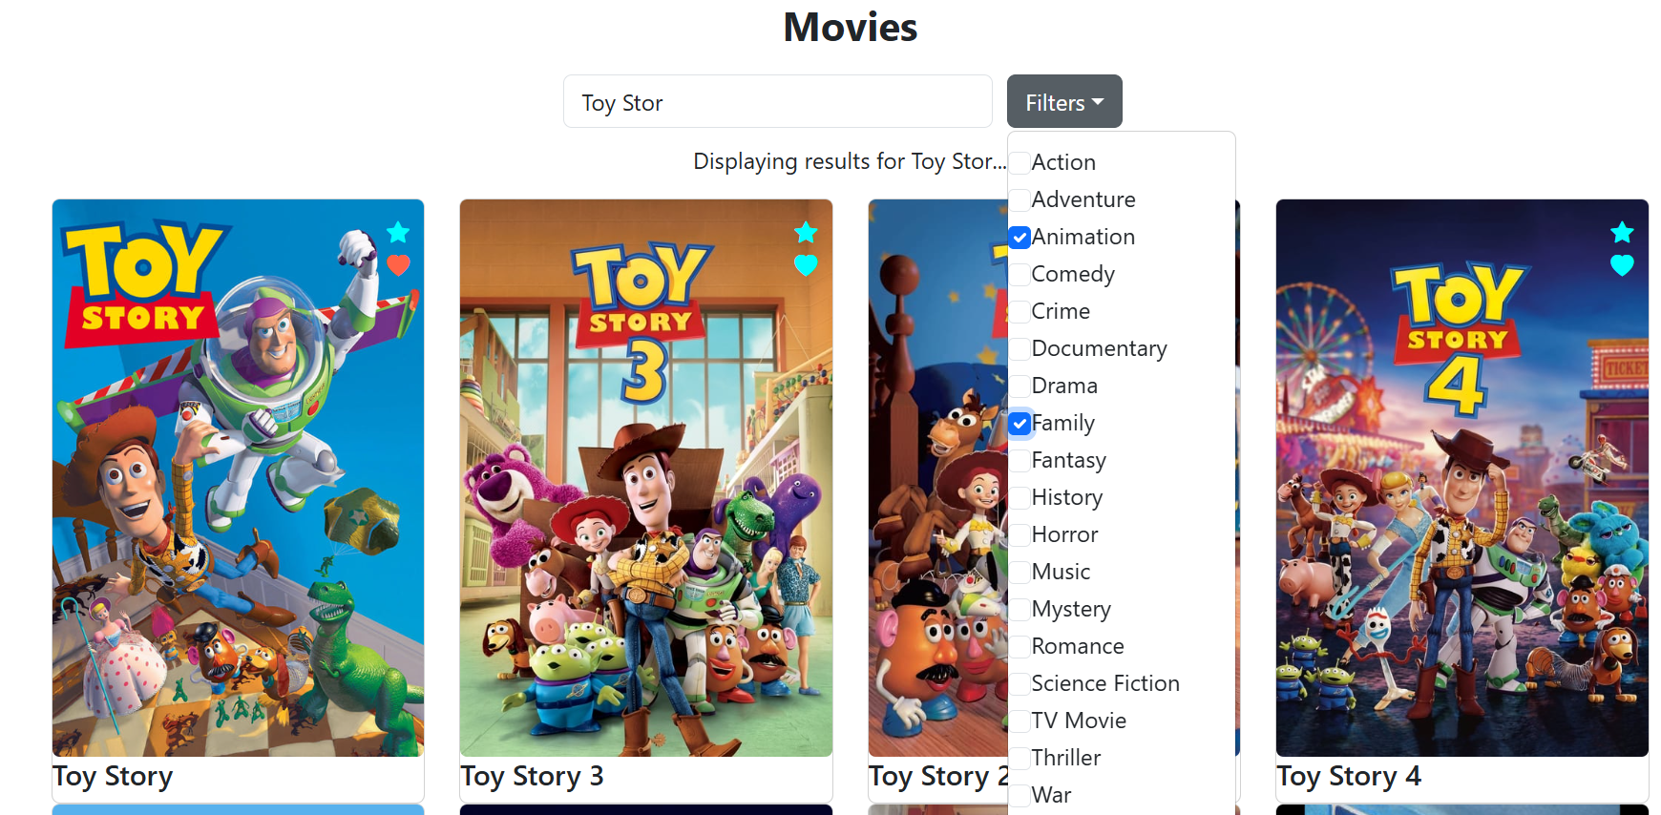
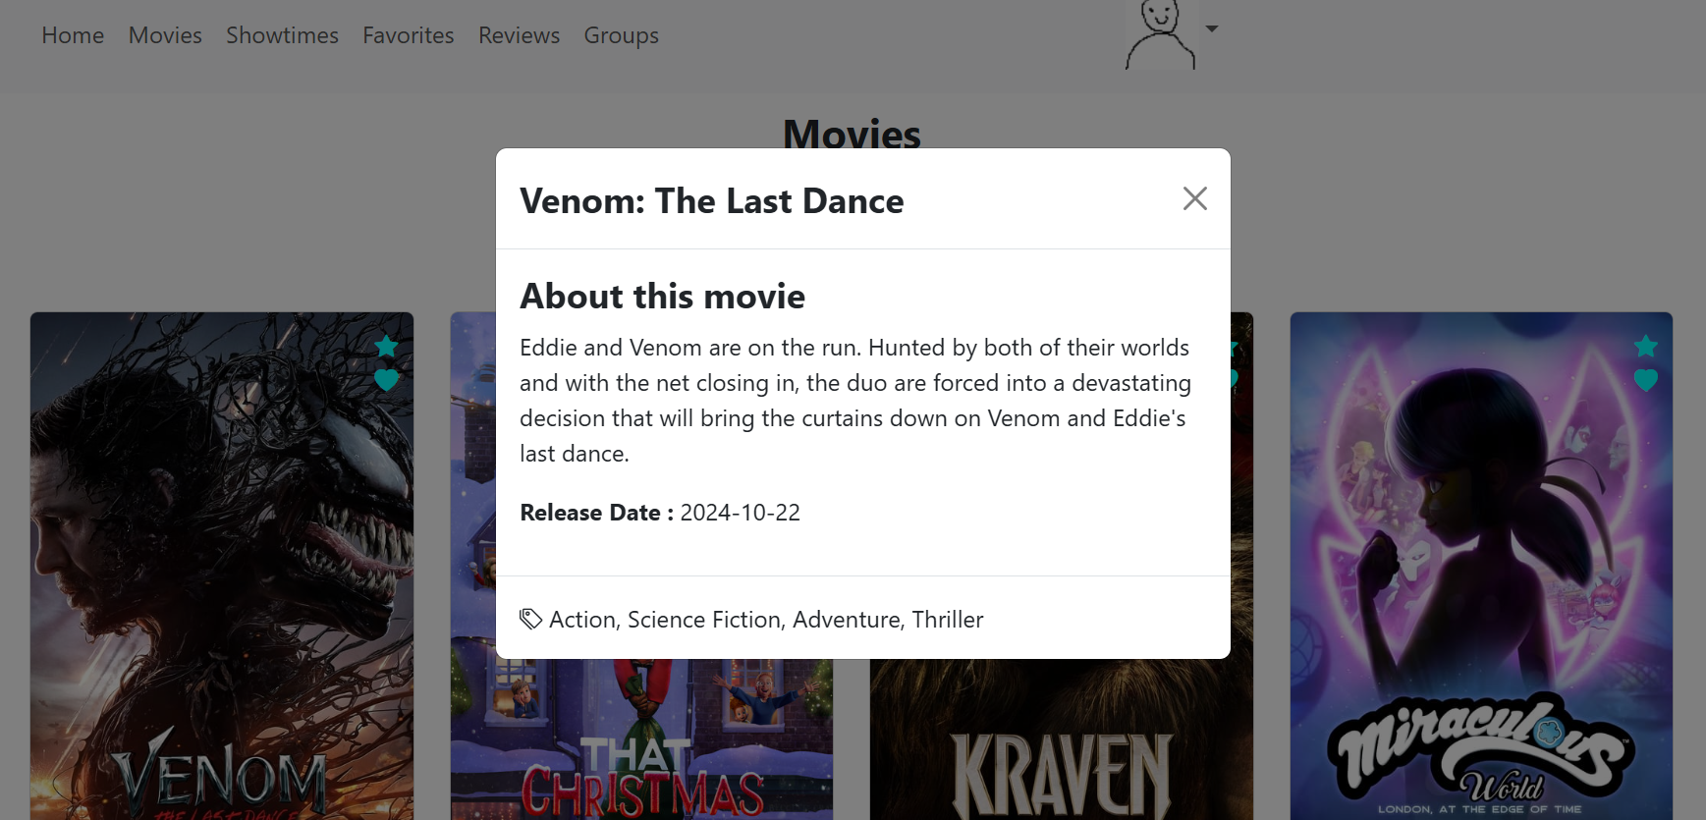
Mikko Hirvonen
Worked on:
Movies
Initial Planning (UI)
Total hours: ~97h

Slide 6
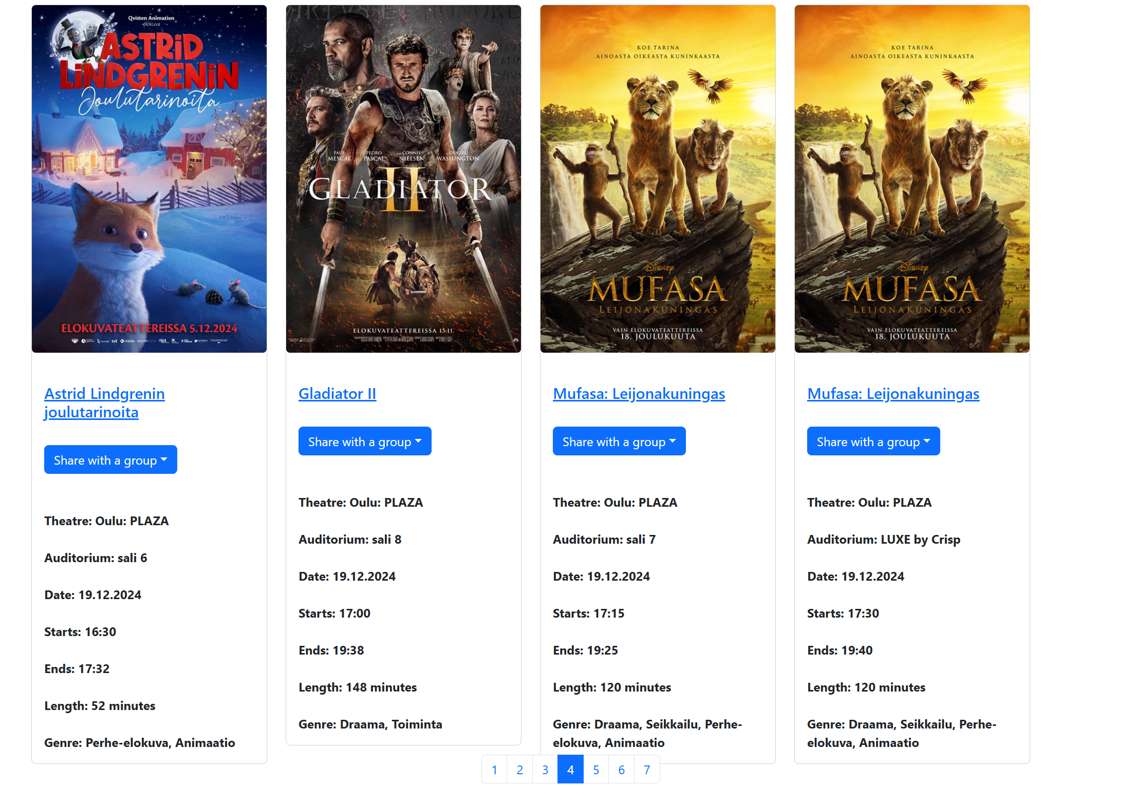
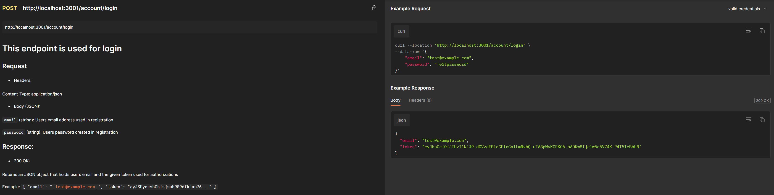
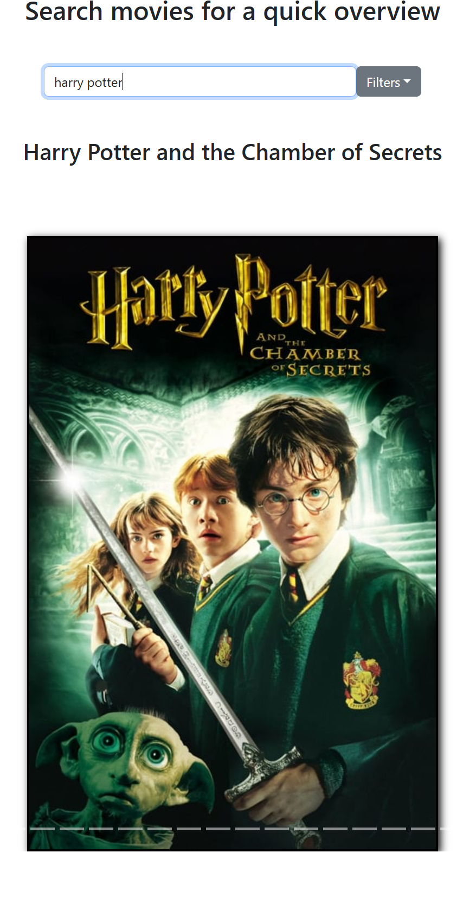
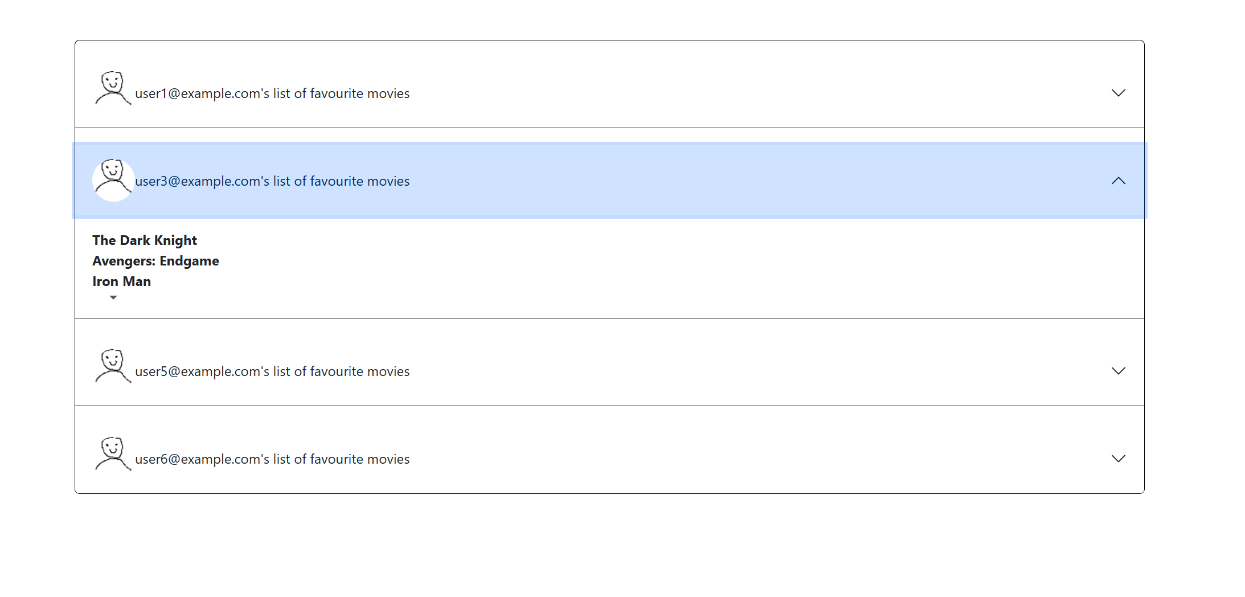
Valtteri Putaansuu - Home, showtimes, favourites
Worked on:
Finnkino showtimes page
Favourites page
Home page
Initial planning (DB, UI)
REST documentation
Total hours spent: 82.5

Slide 7
Where did we succeed?
And where did we end up failing?

Slide 8
Our triumphs
We succeeded in putting together the desired project

Slide 9
Our challenges
Prioritization: sometimes we might have used a bit too much time for "unnecessary" visual fine-tuning before the actual project / sprint goals were met
On the last sprint, few features were left unfinished
The project backlog was not always up-to-date during the weekly meetings

Slide 10
What did we learn?

Slide 11
Our discoveries
We learned to use react and react bootstrap frameworks
We learned to construct a cohesive website and implement working backend and API calls

